Slide 1

Adaptive Regret Minimization in Bounded Memory Games
Jeremiah Blocki, Nicolas Christin,
Anupam Datta, Arunesh Sinha
GameSec 2013 – Invited Paper

Slide 2
Outline
Motivation
Background
Bounded Memory Games
Adaptive Regret
Results
Notes:
I will first introduce the Speeding Game as a motivation for our work. I will introduce the standard notion of regret minimization using this example, and then we will compare the performance of regret minimization algorithm with the performance a stackelberg strategy. We will see that the speeding game motivates the need for a new approach: Adaptive Regret Minimization in Bounded Memory Games. During the rest of the talk I will introduce our new game notions: bounded memory games and adaptive regret. Finally, I will briefly discuss our main technical results.

Slide 3


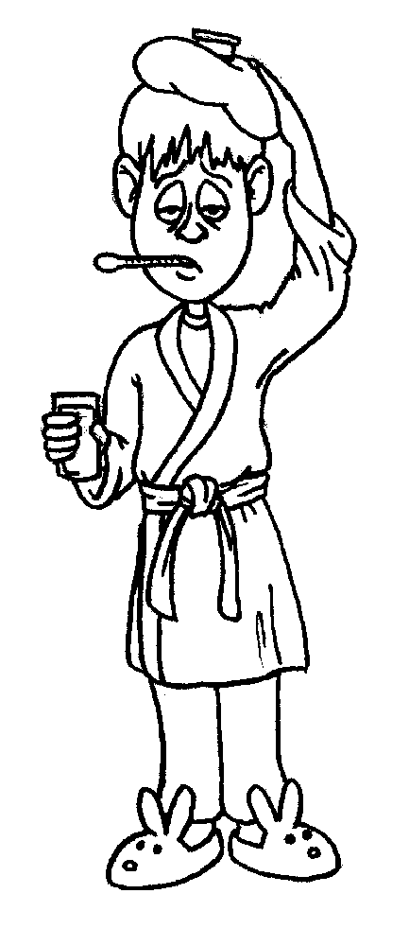


Motivating Example: Audit Game

Slide 4


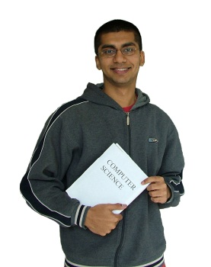


Motivating Example: Cheating Game
Semester 1
Semester 2
Semester 3

Slide 5
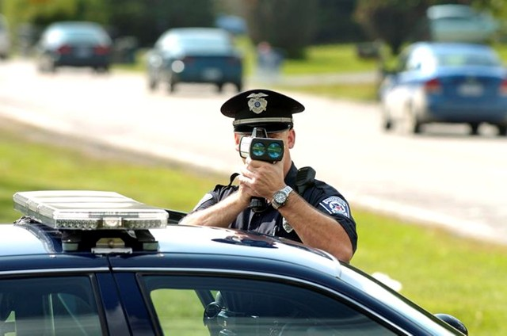



Motivating Example: Speeding Game
Week 1
Week 2
Week 3
Notes:
In the speeding game a defender allocates resources (policemen) to enforce the speed limit. We consider a subtle, but important twist. What if the defender is enforcing the speed limit at popular tourist destination, where new tourists (drivers) arrive every week.

Slide 6

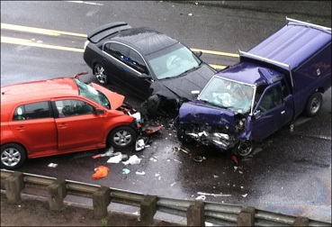

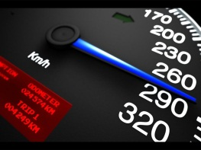
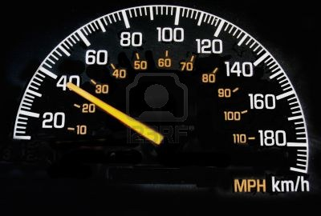



Motivating Example: Speeding Game
Example
Questions
Appropriate Game Model for this Interaction?
Defender Strategies?
Actions
Outcomes
Speed
Behave
:
High Inspection
Low Inspection
:
Notes:
How should we model this interaction as a game, and how should the defender play? Lets start off by formulating this interaction as a repeated game. Every day the adversary (tourist) takes an action: speed or behave. Similarly, the defender takes an action (high inspection) or low inspection. The defender may not observe the action of the adversary, but each day there is an outcome which is observed by everyone: perhaps the policeman gives the adversary a ticket, perhaps there is a crash or perhaps nothing happens. A particular action profile does not necessarily guarantee a particular outcome that day. However, the probability of each outcome will depend on the actions of the adversary and the defender. For example, if the adversary decides to speed it is more likely that there will be an accident that day (either himself or someone else).

Slide 7
Elements of the Game Model
Example
Two Players:
  Adversary (Tourists) and Defender (Policeman)
Actions:
  Adversary Actions: {Speed, Behave}
  Defender Actions: {High Inspection, Low Inspection}
Repeated Interactions
  Each interaction has an outcome
  History of game play is a sequence of outcomes
Imperfect Information:
  The policeman doesn’t always observe the actions of the tourist and vice versa

Slide 8
Game Elements
Repeated Interaction
  Two Players: Defender and Adversary
Imperfect Information
  Defender only observes outcome
Short Term Adversaries
Adversary Incentives Unknown to Defender
  Last presentation! [JNTP 13]
Adversary may be uninformed/irrational
Repeated Game Model?
Stackelberg
Notes:
First, Aristotle was paying attention to the last presentation so he immediately points out that the adversary incentives are probably not known to the defender. Second, Aristotle point out that the adversary is a sequence of tourists. When a tourist arrives he is initially uninformed about the defender’s strategy (he probably won’t bother to look up data on how many tickets were given out in the last month). Aristotle also points out that the reward function itself is history dependent. The adversary’s actions are adaptive (e.g., a tourist who gets a ticket on day 1 might start behaving), but Aristotle points out that the adversary’s strategy is unknown to the defender.

Slide 9
Additional Game Elements
History-dependent Actions
    Adversary adapts behavior following unknown strategy
    How should defender respond?
History-dependent Rewards:
  Point System
  Reputation of defender depends both on its history and on the current outcome
Standard
Regret
Minimization
Repeated Game Model?
Notes:
First, Aristotle was paying attention to the last presentation so he immediately points out that the adversary incentives are probably not known to the defender. Second, Aristotle point out that the adversary is a sequence of tourists. When a tourist arrives he is initially uninformed about the defender’s strategy (he probably won’t bother to look up data on how many tickets were given out in the last month). Aristotle also points out that the reward function itself is history dependent. The adversary’s actions are adaptive (e.g., a tourist who gets a ticket on day 1 might start behaving), but Aristotle points out that the adversary’s strategy is unknown to the defender.

Slide 10
Outline
Motivation
Background
  Standard Definition of Regret
  Regret Minimization Algorithms
  Limitations
Bounded Memory Games
Adaptive Regret
Results
Notes:
I will first introduce the Speeding Game as a motivation for our work. I will introduce the standard notion of regret minimization using this example, and then we will compare the performance of regret minimization algorithm with the performance a stackelberg strategy. We will see that the speeding game motivates the need for a new approach: Adaptive Regret Minimization in Bounded Memory Games. During the rest of the talk I will introduce our new game notions: bounded memory games and adaptive regret. Finally, I will briefly discuss our main technical results.

Slide 11





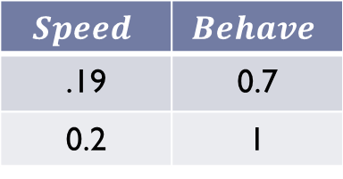
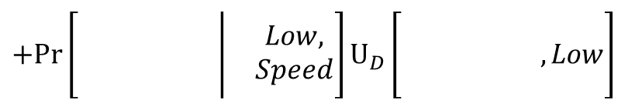
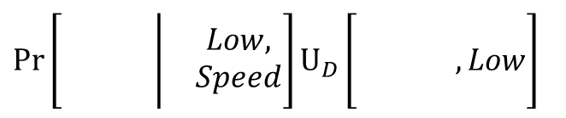
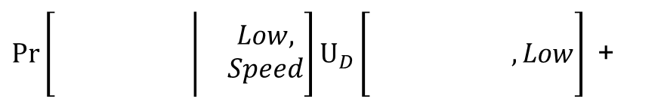
Speeding Game: Repeated Game Model
Example
Defender’s (D) Expected Utility
$$Speed$$ | $$Behave$$
.19 | 0.7
0.2 | 1
High Inspection
Low Inspection
$\operatorname{Pr}\left[\begin{matrix}\left.\begin{matrix} & & \\ & & \\ & & \end{matrix}\right| & \begin{matrix}Low, \\ Speed\end{matrix}\end{matrix}\right]U_{D}\left[\begin{matrix} & & \\ & & \\ & & \end{matrix} ,Low\right]$+
$\operatorname{Pr}\left[\begin{matrix}\left.\begin{matrix} & \\ & \\ & \end{matrix}\right| & \begin{matrix}Low, \\ Speed\end{matrix}\end{matrix}\right]U_{D}\left[\begin{matrix} & \\ & \\ & \end{matrix} , Low\right]$
$+Pr\left[\begin{matrix}\left.\begin{matrix} & & \\ & & \\ & & \end{matrix}\right| & \begin{matrix}Low, \\ Speed\end{matrix}\end{matrix}\right]U_{D}\left[\begin{matrix} & & \\ & & \\ & & \end{matrix}, Low\right]$
Notes:
We can now calculate the defender’s expected utility given each action profile. The utilities in the table reflects the fact that it costs the adversary more money to take the action high inspection, and if the user behaves then a crash is less likely.

Slide 12
Speeding Game: Repeated Game Model
Example
Defender’s (D) Expected Utility
$$Speed$$ | $$Behave$$
.19 | 0.7
0.2 | 1
High Inspection
Low Inspection
Notes:
We can now calculate the defender’s expected utility given each action profile. The utilities in the table reflects the fact that it costs the adversary more money to take the action high inspection, and if the user behaves then a crash is less likely.

Slide 13
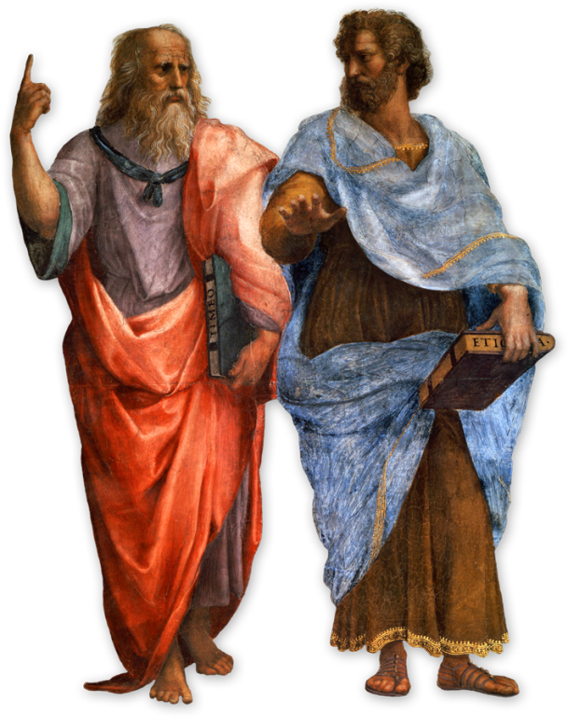
Regret Minimization Example
Example
Experts
What should I do?
Low Inspection
High Inspection
Notes:
Once we have quantified the defender’s expected utility, we might ask what actions the defender should take. One strategy the defender could use is called regret minimization. Let’s imagine that each day the defender can consult several experts (Plato and Aristotle) before taking his action. Here Aristotle points down to indicate that the defender should play Low Inspection and Plato points up to indicate that the defender should play high inspection.

Slide 14
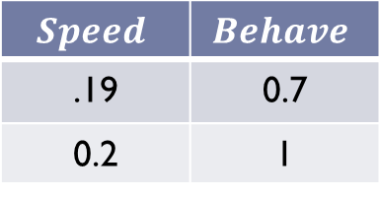
Regret Minimization Example
Example
Defender’s Utility
$$Speed$$ | $$Behave$$
.19 | 0.7
0.2 | 1
High Inspection
Low Inspection
Experts
0.2
+ 1
+ 1 = 2.2
0.19
+ 1
+ 0.7 = 1.89
Day 1
Day 2
Day 3
Adversary
Defender
Speed
High
Behave
Low
Behave
High
Utility
1.89
Aristotle
Plato
Low
High
Low
High
Low
High
2.2
1.59
Notes:
Now lets suppose that on day 1 the defender decides to follow Plato’s advice and the adversary decides to speed. Then the defender’s utility is 0.19. Maybe on Day 2 the defender follows Aristotle and the adversary Behaves (reward 1) and on day 3 the defender follows plato again an the adversary behaves (reward 0.7).
To define standard notion of regret we ask the following question: what would have happened if we had followed Aristotle’s advice in every round and the adversary played the same actions. In this case Aristotle would receive reward 0.2 on day 1 and reward 1 on days 2 and 3.

Slide 15
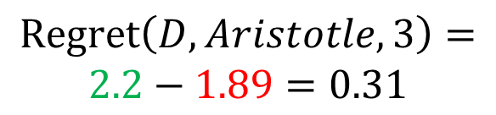
Regret Minimization Example
Example
Defender’s Utility
$$Speed$$ | $$Behave$$
.19 | 0.7
0.2 | 1
High Inspection
Low Inspection
Regret
$$\operatorname{Regret}\left(D,Aristotle,3\right)=$$
$$2.2−1.89=0.31$$
Defender
Aristotle
Plato
Utility
1.89
2.2
0.59
Notes:
Now the regret of the defender with respect to Aristotle after 3 rounds of play is just 2.2 – 1.89 (the reward Aristotle received in our hypothetical scenario minus the reward that the defender actually got).

Slide 16


Regret Minimization Example
Example
Defender’s Utility
$$Speed$$ | $$Behave$$
.19 | 0.7
0.2 | 1
High Inspection
Low Inspection
Regret
$$\operatorname{Regret}\left(D,\{Aristotle,Plato\},T \right)$$
$$=$$
$$\max_{E∈\{Aristotle,Plato\}}\left[Regret\left(D,E,T\right)\right]$$
Notes:
In general, the defenders regret with respect to a set of experts after T rounds of play is the maximum regret over each expert.

Slide 17
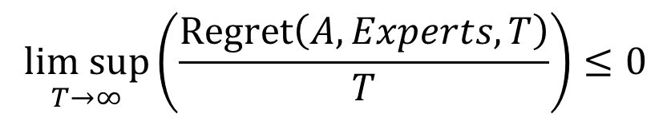
Regret Minimization Example
Example
Defender’s utility
$$Speed$$ | $$Behave$$
.19 | 0.7
0.2 | 1
High Inspection
Low Inspection
Regret Minimization Algorithm (A)
$$\underset{T→∞}{lim sup}\left(\frac{\operatorname{Regret}\left(A,Experts,T\right)}{T}\right)≤0$$
Notes:
A regret minimization algorithm provides the nice guarantee that the average (per round) regret tends to 0 as T grows large. Now that I have defined a regret minimization algorithm (under the standard notion of regret) it is natural to ask what would a regret minimization algorithm do in our speeding game?

Slide 18


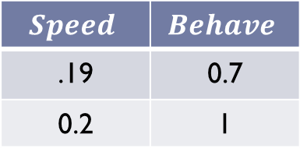
Regret Minimization: Basic Idea
High Inspection
Low Inspection
Choose action probabilistically based on weights
Weights
1.0
1.0
$$Speed$$ | $$Behave$$
.19 | 0.7
0.2 | 1
High Inspection
Low Inspection

Slide 19


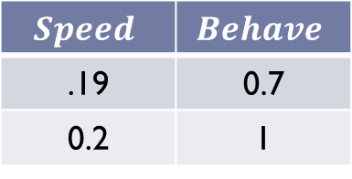
Regret Minimization: Basic Idea
High Inspection
Low Inspection
Updated weights
0.5
1.5
$$Speed$$ | $$Behave$$
.19 | 0.7
0.2 | 1
High Inspection
Low Inspection

Slide 20
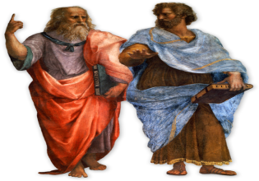


Speeding Game
Example
Defender’s utility
Dominant Strategy
$$Speed$$ | $$Behave$$
.19 | 0.7
0.2 | 1
High Inspection
Low Inspection
Defender’s Strategy
High Inspection
Low Inspection
Regret Minimization: Low Inspection
Nash Equilibrium: Low Inspection
0.5
1.5
Notes:
In this case notice that the defender action: Low Inspection is a dominant strategy. It doesn’t matter what action the adversary takes. The defender will always get better expected utility by playing low inspection. This means that our regret minimization algorithm will converge to following Aristotle’s advice all of the time. Similarly, in any Nash Equilibrium the Defender will always play Low Inspection.

Slide 21
Speeding Game
Example
Defender’s utility
Dominant Strategy
$$Speed$$ | $$Behave$$
.19 | 0.7
0.2 | 1
High Inspection
Low Inspection
Defender’s Strategy
High Inspection
Low Inspection
Regret Minimization: Low Inspection
Nash Equilibrium: Low Inspection
0.3
1.7
Notes:
In this case notice that the defender action: Low Inspection is a dominant strategy. It doesn’t matter what action the adversary takes. The defender will always get better expected utility by playing low inspection. This means that our regret minimization algorithm will converge to following Aristotle’s advice all of the time. Similarly, in any Nash Equilibrium the Defender will always play Low Inspection.

Slide 22
Speeding Game
Example
Defender’s utility
Dominant Strategy
$$Speed$$ | $$Behave$$
.19 | 0.7
0.2 | 1
High Inspection
Low Inspection
Defender’s Strategy
High Inspection
Low Inspection
Regret Minimization: Low Inspection
Nash Equilibrium: Low Inspection
0.1
1.9
Notes:
In this case notice that the defender action: Low Inspection is a dominant strategy. It doesn’t matter what action the adversary takes. The defender will always get better expected utility by playing low inspection. This means that our regret minimization algorithm will converge to following Aristotle’s advice all of the time. Similarly, in any Nash Equilibrium the Defender will always play Low Inspection.

Slide 23
Prior Work: Regret Minimization
Regret Minimization well studied in repeated games with imperfect information (bandit model)
    [AK04, McMahanB04,K05,FKM05, DH06,…]
Regret Minimizing Audits [BCDS11]

Slide 24
Philosophical Argument
We need a better game model!
See! My advice was better!
Notes:
Now we get into a philosophical argument. Aristotle taunts Plato, and Plato responds by telling Aristotle that the game model is flawed. He still thinks his advice would be better in a realistic game model. Let’s allow Plato to make his case.

Slide 25


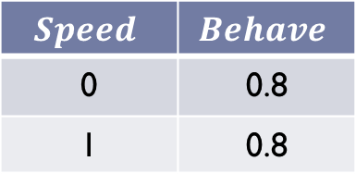
Speeding Game
Example
Defender’s utility
$$Speed$$ | $$Behave$$
.19 | 0.7
0.2 | 1
High Inspection
Low Inspection
Adversary’s utility
Dominant Strategy/
Best Response
$$Speed$$ | $$Behave$$
0 | 0.8
1 | 0.8
High Inspection
Low Inspection
Notes:
Plato starts out by introducing the following utility function for the adversary. Plato points out that if the defender follows Aristotle’s advice then the adversaries best response is to speed. The resulting defender utility is just 0.2.

Slide 26
Speeding Game: Stackelberg Model
Example
Defender’s utility
$$Speed$$ | $$Behave$$
.19 | 0.7
0.2 | 1
High Inspection
Low Inspection
Stackelberg
Strategy
Adversary’s utility
Best Response
$$Speed$$ | $$Behave$$
0 | 0.8
1 | 0.8
High Inspection
Low Inspection
Notes:
Plato now argues that his advice is better in a stackelberg game model where the defender (leader) can commit to following his advice (high inspection). In this case a rational adversary (follower) will play his best response: behave. The resulting defender utility is now 0.7 instead of 0.2.

Slide 27
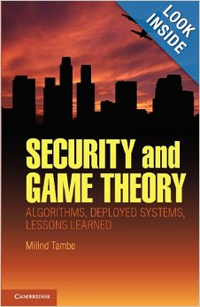
Prior Work: Stackelberg Games and Security
Security Games [Tam12]
  [JPQ+],[JNTP13],…
  LAX, Air Marshals
Audit Games [BCD+13]

Slide 28
Philosophical Argument
See! My advice was really better!
Your Stackelberg game model is still flawed!
Notes:
Plato now tells Aristotle that his advice was actually better if we consider an adversary who adapts. Aristotle responds by criticizing Plato’s Stackelberg game model. Let’s allow Aristotle to make his complaint.

Slide 29
Unmodeled Game Elements
Adversary Incentives Unknown to Defender
  Last presentation! [JNTP 13]
Adversary may be uninformed/irrational
History-dependent Rewards:
  Point System
  Reputation of defender depends both on its history and on the current outcome
History-dependent Actions
    Adversary adapts behavior following unknown strategy
    How should defender respond?
Notes:
First, Aristotle was paying attention to the last presentation so he immediately points out that the adversary incentives are probably not known to the defender. Second, Aristotle point out that the adversary is a sequence of tourists. When a tourist arrives he is initially uninformed about the defender’s strategy (he probably won’t bother to look up data on how many tickets were given out in the last month). Aristotle also points out that the reward function itself is history dependent. The adversary’s actions are adaptive (e.g., a tourist who gets a ticket on day 1 might start behaving), but Aristotle points out that the adversary’s strategy is unknown to the defender.

Slide 30
Outline
Motivation
Background
Bounded Memory Games
Adaptive Regret
Results
Notes:
To address these issues we introduce a new game model --- bounded memory games --- and a novel notion of regret called adaptive regret.

Slide 31


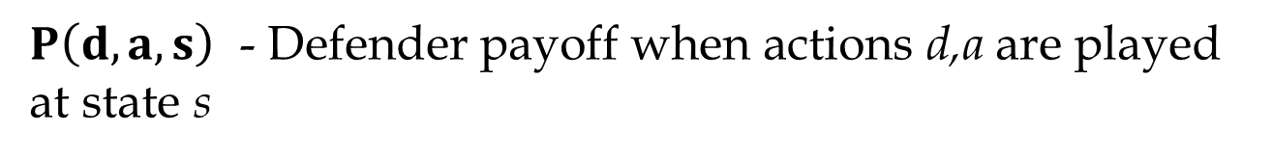


Stochastic Games
States: captures dependence of rewards on history
Thm: No algorithm can
minimize regret for the general class of stochastic games.
$$a≠d$$
s₁
s₀
$$a=d$$
s₂
$P\left(d,a,s\right)$ - Defender payoff when actions d,a are played at state s
Notes:
Before I introduce Bounded Memory Games let me briefly talk about stochastic games. In each round of a stochastic game the defender and the adversary play an action, receive a reward and transition to a new state. Because the reward function depends on the actions of the adversary and the defender as well as the state of the game, we can use states to capture history dependent rewards. In the example, the game transitions from initial state 0 to state 2 if and only if the adversaries action a, matches the defenders action d. Otherwise the game transitions to state 1. Our simple example proves that it is impossible to build a regret minimization algorithm for stochastic games. One expert will take use to the happy state and one expert will take us to the sad state, but it is impossible to know which one to follow ahead of time!

Slide 32


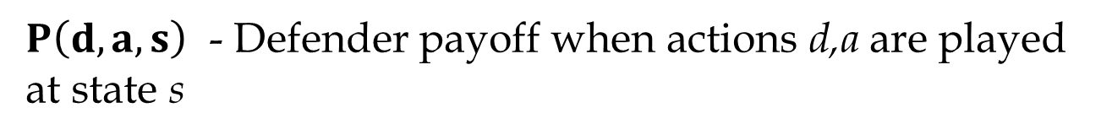

Bounded Memory Games
State s: Encodes last m outcomes
States: can capture history dependent rewards
$$O_{i−m},…,O_{i−2},O_{i−1}$$
$$O_{i}$$
$$O_{i−m+1},…,O_{i−1},O_{i}$$
$P\left(d,a,s\right)$ - Defender payoff when actions d,a are played at state s
Notes:
Bounded memory games are a subclass of stochastic games. In a bounded memory game the states encode the last m outcomes. Recall that the outcome in a particular round is only dependent on the actions in that round. Thus our current state only depends on the action profiles from the last m rounds. If we observe an outcome Oi then we transition to the state on the right.

Slide 33









Bounded Memory Games
State s: Encodes last m outcomes
Current outcome is only dependent on current actions
$$\operatorname{Pr}\left[\begin{matrix} & \left|\begin{matrix}s, & \begin{matrix} & \\ & \\ & \end{matrix}\end{matrix}\right.\end{matrix}\right]=\operatorname{Pr}\left[\begin{matrix}O_{i} & \left|\begin{matrix}s^{′}, & \begin{matrix} & \\ & \\ & \end{matrix}\end{matrix}\right.\end{matrix}\right]$$
$$\begin{matrix} , & \end{matrix},…,$$
$$,…, ,$$
$P\left(d,a,s\right)$ - Defender payoff when actions d,a are played at state s
Notes:
Bounded memory games are a subclass of stochastic games. In a bounded memory game the states encode the last m outcomes. Recall that the outcome in a particular round is only dependent on the actions in that round. Thus our current state only depends on the action profiles from the last m rounds. If we observe an outcome Oi then we transition to the state on the right.

Slide 34
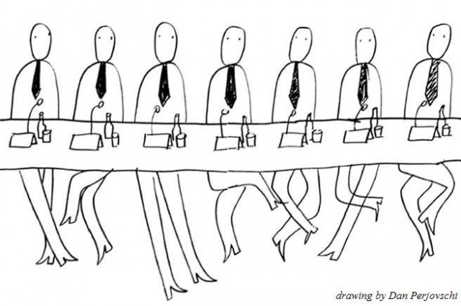
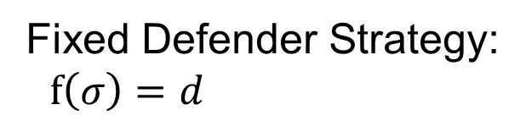
Bounded Memory Games - Experts
Expert advice may depend on the last m outcomes
If no violations have been detected in the last m rounds then play High Inspection, otherwise Low Inspection
Fixed Defender Strategy:
$f\left(σ\right)=d$
State
Action
Notes:
Now that we have added states to the game, we also allow each expert to see the current state before he gives his advice. A fixed defender strategy is just a function mapping states to actions. For example, one expert might suggest high inspection only when no violations have been detected in the last m rounds.
Now we have a new technical challenge. There are exponentially many experts, and a typical regret regret minimization algorithm explicitly maintaining a weight for each expert, which scores how well that expert has done in the past.

Slide 35
Outline
Motivation
Background
Bounded Memory Games
Adaptive Regret
Results

Slide 36








k-Adaptive Strategy
Decision tree for the next k rounds
Speed
Day 1
Speed
Speed
Day 2
Speed
Speed
Speed
Behave
Day 3
…
…
…
…
…
Notes:
A k-Adaptive strategy is a complete decision tree for the next k rounds. Here are several examples of 7-adaptive strategies that the tourists might adopt. These strategies are unknown to the defender, but in hindsight we can see that the following fixed strategy will be optimal for the defender.

Slide 37
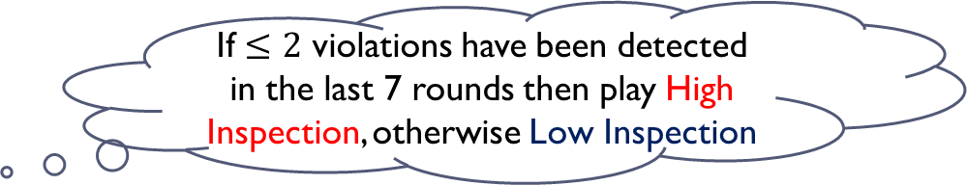
k-Adaptive Strategy
Decision tree for the next k rounds
If $≤2$ violations have been detected in the last 7 rounds then play High Inspection, otherwise Low Inspection
I will keep speeding until I get two tickets. If I ever get two tickets then I will stop.
I will never speed while I am on vacation.
I will speed until I get caught. If I ever get a ticket then I will stop.
Week 1
Week 2
Week 3
Notes:
A k-Adaptive strategy is a complete decision tree for the next k rounds. Here are several examples of 7-adaptive strategies that the tourists might adopt. These strategies are unknown to the defender, but in hindsight we can see that the following fixed strategy will be optimal for the defender.

Slide 38



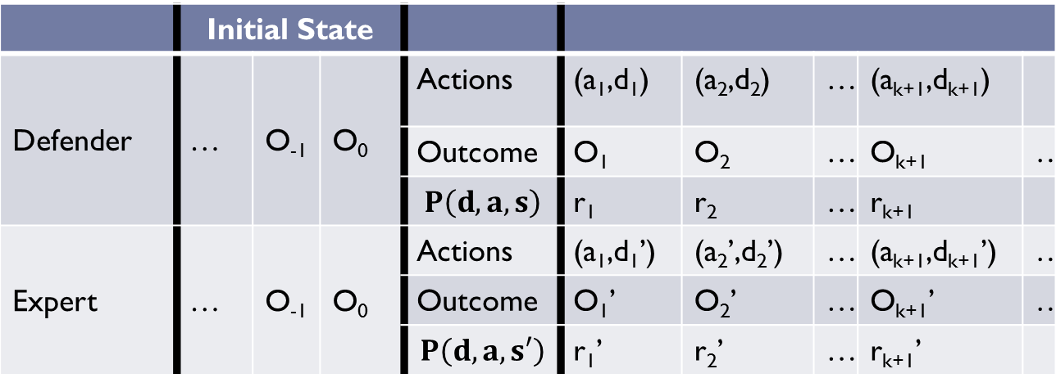
k-Adaptive Regret
 | Initial State
Defender | … | O₋₁ | O₀ | Actions | (a₁,d₁) | (a₂,d₂) | … | (a_{k+1},d_{k+1})
 |  |  |  | Outcome | O₁ | O₂ | … | O_{k+1} | …
 |  |  |  | $$P\left(d,a,s\right)$$ | r₁ | r₂ | … | r_{k+1}
Expert | … | O₋₁ | O₀ | Actions | (a₁,d₁’) | (a₂’,d₂’) | … | (a_{k+1},d_{k+1}’) | …
 |  |  |  | Outcome | O₁’ | O₂’ | … | O_{k+1}’ | …
 |  |  |  | $$P\left(d,a,s′\right)$$ | r₁’ | r₂’ | … | r_{k+1}’
$$\operatorname{Regret}\left(D,Expert,T\right)=\sum_{i=1}^{T}{\left(ri^{′}−ri\right)}$$
Notes:
The notion of k-adaptive regret is similar to the standard notion with one key difference. K-adaptive regret takes into account the fact that the game will evolve differently when Aristotle plays. We don’t get to observe the outcomes/actions when Aristotle plays so we may not be able to compute the Regret. Nevertheless the function is well defined.
Observe that the adversaries actions in rounds 1 and k+1 are identical because a new tourist can’t adapt his actions based on history.

Slide 39
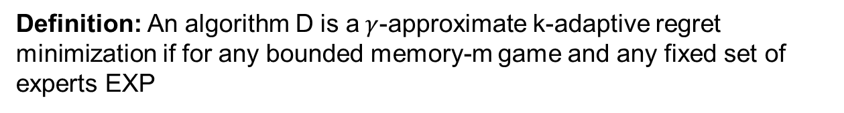

k-Adaptive Regret Minimization
Definition: An algorithm D is a$γ$-approximate k-adaptive regret minimization if for any bounded memory-m game and any fixed set of experts EXP
$$\underset{T→∞}{lim sup}\left(\max_{E∈EXP}{\frac{Regret\left(D,E,T\right)}{T}}\right)≤γ.$$
Notes:
The definition of a gamma-approximate k-adaptive regret minimization algorithm guarantees that the average k-adaptive regret is bounded by gamma as T grows large. When gamma and k are 0 this notion corresponds to the standard notion of k-adaptive regret. If there is an efficient k-Adaptive regret minimization algorithm then this could be a great strategy for our defender to use.

Slide 40
Outline
Motivation
Background
Bounded Memory Games
Adaptive Regret
Results

Slide 41

k-Adaptive Regret Minimization
Definition: An algorithm D is a$γ$-approximate k-adaptive regret minimization if for any bounded memory-m game and any fixed set of experts EXP
$$\underset{T→∞}{lim sup}\left(\max_{E∈EXP}{\frac{Regret\left(D,E,T\right)}{T}}\right)≤γ.$$
Theorem: For any $γ>0,k≥0$ there is an inefficient $γ$–approximate k-adaptive regret minimization algorithm.

Slide 42





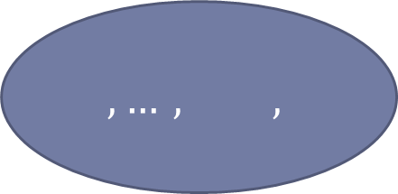
Inefficient Regret Minimization Algorithm
Bounded Memory-m
Game
$$\begin{matrix} , & \end{matrix},…,$$
$$,…, ,$$
Repeated Game
 |  | …
f₁
f₂
…
fixed strategy
Use standard regret minimization algorithm for repeated games of imperfect information [AK04, McMahanB04,K05,FKM05]
Notes:
Note: That these algorithms are inefficient because they require us to explicitly maintain weights over exponentially many experts

Slide 43

Inefficient Regret Minimization Algorithm
Bounded Memory-m
Game
Expected reward in original game given:
Defender follows fixed strategy f₂ for next mkt rounds of original game
Start state is ( , …, )
Defender sees sequence of k-adaptive adversaries below
$$\begin{matrix} , & \end{matrix},…,$$
$$,…, ,$$
Repeated Game
 |  | …
f₁
f₂
…
fixed strategy
Use standard regret minimization algorithm for repeated games of imperfect information [AK04, McMahanB04,K05,FKM05]
Notes:
Note: That these algorithms are inefficient because they require us to explicitly maintain weights over exponentially many experts

Slide 44
Inefficient Regret Minimization Algorithm
Reduce Bounded Memory Game to a repeated game
Defender Actions: Select a fixed strategy to follow for each stage
Adversary Actions: Select an adaptive strategy to follow for the stage
Use standard regret minimization algorithm for repeated games of imperfect information [AK04, McMahanB04,K05,FKM05]
Round i-1
Round i
Stage_{i-1} |  |  | Stage_{i} (m*k*t rounds)
… | O₋₁ | O₀ | O₁ | … | O_{m} | … | O_{mkt}
Notes:
Note: That these algorithms are inefficient because they require us to explicitly maintain weights over exponentially many experts

Slide 45


Inefficient Regret Minimization Algorithm
Current outcome is only dependent on current actions
$$\operatorname{Pr}\left[\begin{matrix} & \left|\begin{matrix}s, & \begin{matrix} & \\ & \\ & \end{matrix}\end{matrix}\right.\end{matrix}\right]=\operatorname{Pr}\left[\begin{matrix}O_{i} & \left|\begin{matrix}s^{′}, & \begin{matrix} & \\ & \\ & \end{matrix}\end{matrix}\right.\end{matrix}\right]$$
 | Start State |  |  | Stage_{i} (m*k*t rounds)
Real Game | … |  |  | O₁ | … | O_{m} | …
Repeated Game | … |  |  | O₁ | … | O_{m} | …
Notes:
We are minimizing regret with respect to View 2, we want to minimize regret with respect to View 3!

Slide 46
Inefficient Regret Minimization Algorithm
 | Start State |  |  | Stage_{i} (m*k*t rounds)
Real Game | … |  |  | O₁ | … | O_{m} | …
Repeated Game | … |  |  | O₁ | … | O_{m} | …
After m rounds in Stage_{i} View 1 and View 2 must converge to the same state
Notes:
We are minimizing regret with respect to View 2, we want to minimize regret with respect to View 3!

Slide 47
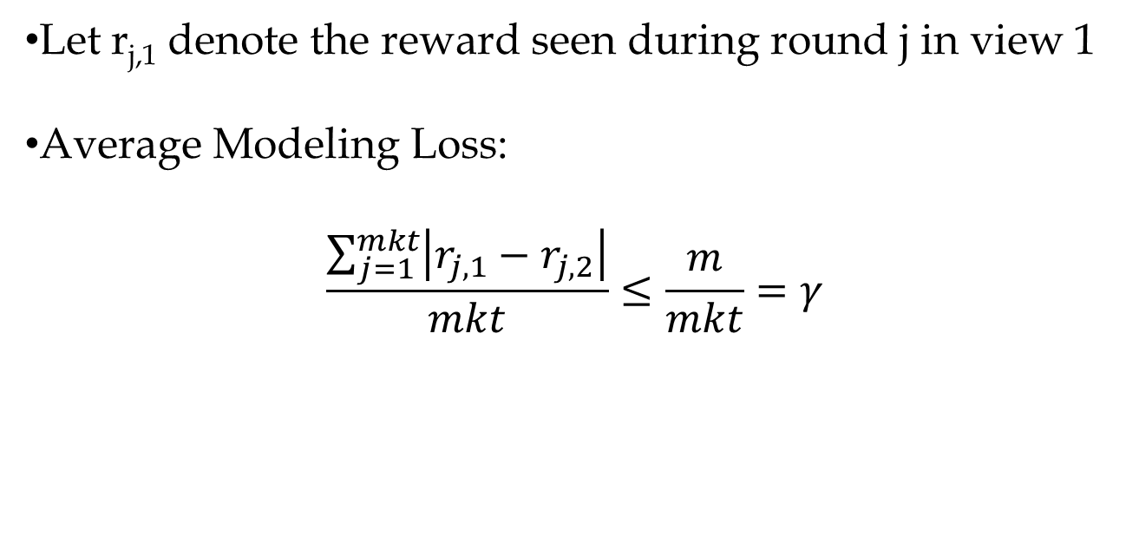
Inefficient Regret Minimization Algorithm
 | Start State |  |  | Stage_{i} (m*k*t rounds)
Real Game | … |  |  | O₁ | … | O_{m} | …
Repeated Game | … |  |  | O₁ | … | O_{m} | …
Let r_{j,1} denote the reward seen during round j in view 1
Average Modeling Loss:
$$\frac{\sum_{j=1}^{mkt}{\left|r_{j,1}−r_{j,2}\right|}}{mkt}≤\frac{m}{mkt}=γ$$
Notes:
We are minimizing regret with respect to View 2, we want to minimize regret with respect to View 3!

Slide 48
Inefficient Regret Minimization Algorithm
 | Stage_{i-1} |  |  | Stage_{i} (m*k*t rounds)
View 1: | … | O₋₁ | O₀ | O₁ | … | O_{m} | …
View 2: | … | O’₋₁ | O’₀ | O₁ | … | O_{m} | …
View 1 – Play strategy f beginning in stage_{i}
View 2 – Play strategy f from beginning
  Previous Outcomes O’₋₁,O’₀ may be different!
After m rounds in Stage_{i} View 1 and View 2 must converge to the same state

Slide 49
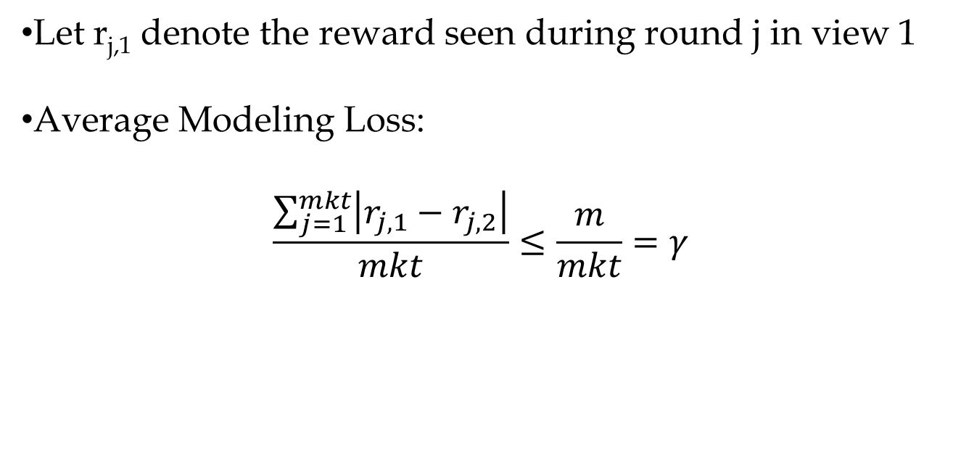
Inefficient Regret Minimization Algorithm
 | Stage_{i-1} |  |  | Stage_{i} (m*k*t rounds)
View 1: | … | O₋₁ | O₀ | O₁ | … | O_{m} | …
View 2: | … | O’₋₁ | O’₀ | O₁ |  | O_{m} | …
Let r_{j,1} denote the reward seen during round j in view 1
Average Modeling Loss:
$$\frac{\sum_{j=1}^{mkt}{\left|r_{j,1}−r_{j,2}\right|}}{mkt}≤\frac{m}{mkt}=γ$$

Slide 50
Inefficient Regret Minimization Algorithm
Bounded Memory-m
Game
$$\begin{matrix} , & \end{matrix},…,$$
$$,…, ,$$
Repeated Game
Standard Regret Minimization algorithms maintain weight for each expert.
Inefficient: Exponentially many fixed strategies!
 |  | …
f₁
f₂
…
fixed strategy
Use standard regret minimization algorithm for repeated games of imperfect information [AK04, McMahanB04,K05,FKM05]
Notes:
Note: That these algorithms are inefficient because they require us to explicitly maintain weights over exponentially many experts

Slide 51
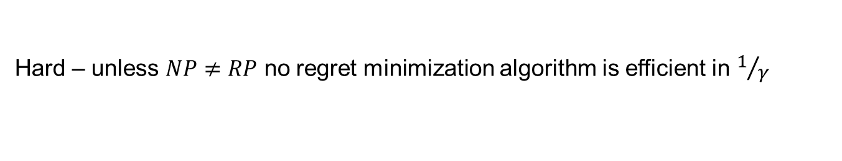
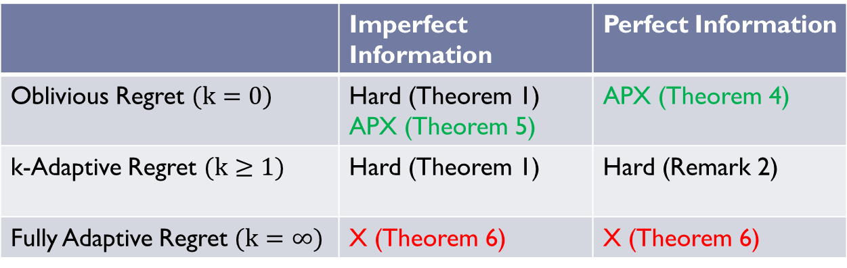
Summary of Technical Results
 | Imperfect Information | Perfect Information
Oblivious Regret $(k=0)$ | Hard (Theorem 1) APX (Theorem 5) | APX (Theorem 4)
k-Adaptive Regret $(k≥1)$ | Hard (Theorem 1) | Hard (Remark 2)
Fully Adaptive Regret $(k=∞)$ | X (Theorem 6) | X (Theorem 6)
Easier
X – No Regret Minimization Algorithm Exists
Hard – unless $NP≠RP$ no regret minimization algorithm is efficient in $1/γ$
APX – efficient approximate regret minimization algorithm

Slide 52
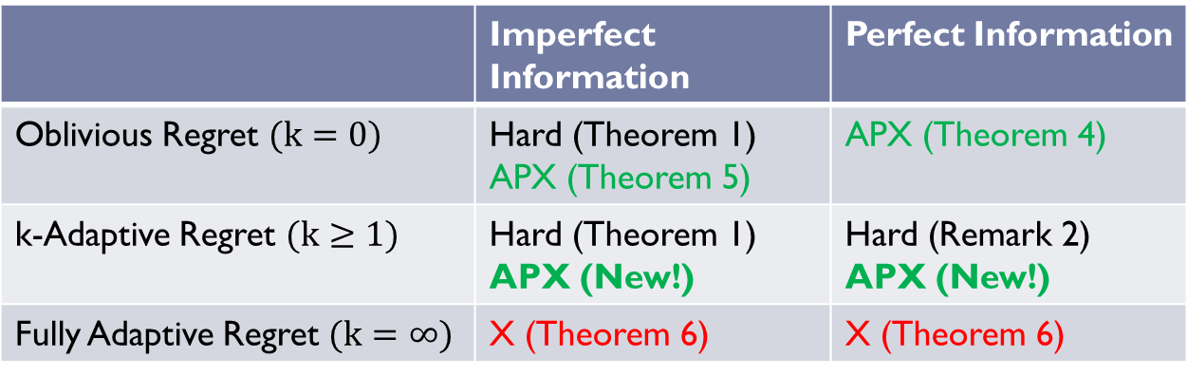
Summary of Technical Results
 | Imperfect Information | Perfect Information
Oblivious Regret $(k=0)$ | Hard (Theorem 1) APX (Theorem 5) | APX (Theorem 4)
k-Adaptive Regret $(k≥1)$ | Hard (Theorem 1) APX (New!) | Hard (Remark 2) APX (New!)
Fully Adaptive Regret $(k=∞)$ | X (Theorem 6) | X (Theorem 6)
Easier
X – No Regret Minimization Algorithm Exists
Hard – unless $NP≠RP$ no regret minimization algorithm is efficient in $1/γ$
APX – efficient approximate regret minimization algorithm in n, k

Slide 53
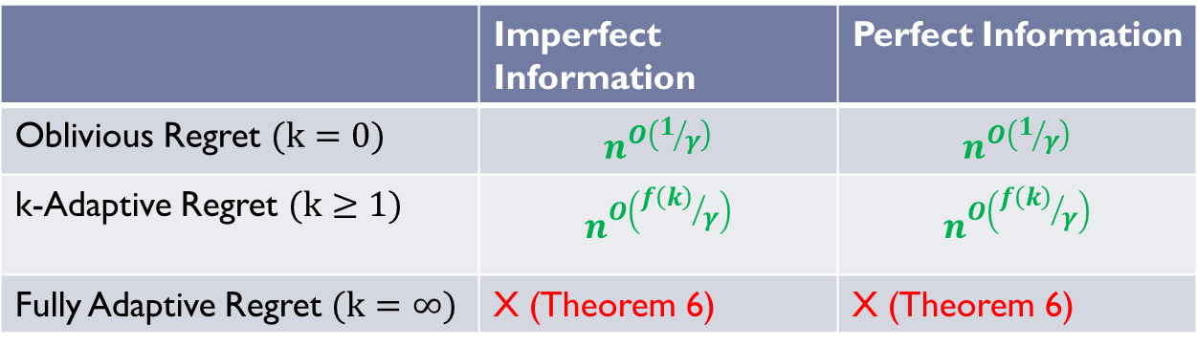
Summary of Technical Results
 | Imperfect Information | Perfect Information
Oblivious Regret $(k=0)$ | $$n^{O\left(1/γ\right)}$$ | $$n^{O\left(1/γ\right)}$$
k-Adaptive Regret $(k≥1)$ | $$n^{O\left({f\left(k\right)}/γ\right)}$$ | $$n^{O\left({f\left(k\right)}/γ\right)}$$
Fully Adaptive Regret $(k=∞)$ | X (Theorem 6) | X (Theorem 6)
Easier
Ideas: Implicit weight representation + Dynamic Programming
Warning! f(k) is a very large constant!

Slide 54








Implicit Weights: Outcome Tree
How often is edge (s,t) relevant?
$$wuv$$
$$n^{O\left(1/γ\right)}$$
Speed
Behave
Speed
Behave
$$wst$$
$$Rst$$
…
…
…
…
Notes:
A k-Adaptive strategy is a complete decision tree for the next k rounds. Here are several examples of 7-adaptive strategies that the tourists might adopt. These strategies are unknown to the defender, but in hindsight we can see that the following fixed strategy will be optimal for the defender.

Slide 55
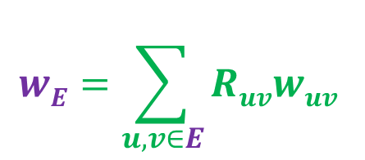
Implicit Weights: Outcome Tree
Expert: E
$$wE=\sum_{u,v∈E}{Ruvwuv }$$
$$wuv$$
$$n^{O\left(1/γ\right)}$$
Speed
Behave
Speed
Behave
…
…
…
…
Notes:
A k-Adaptive strategy is a complete decision tree for the next k rounds. Here are several examples of 7-adaptive strategies that the tourists might adopt. These strategies are unknown to the defender, but in hindsight we can see that the following fixed strategy will be optimal for the defender.

Slide 56
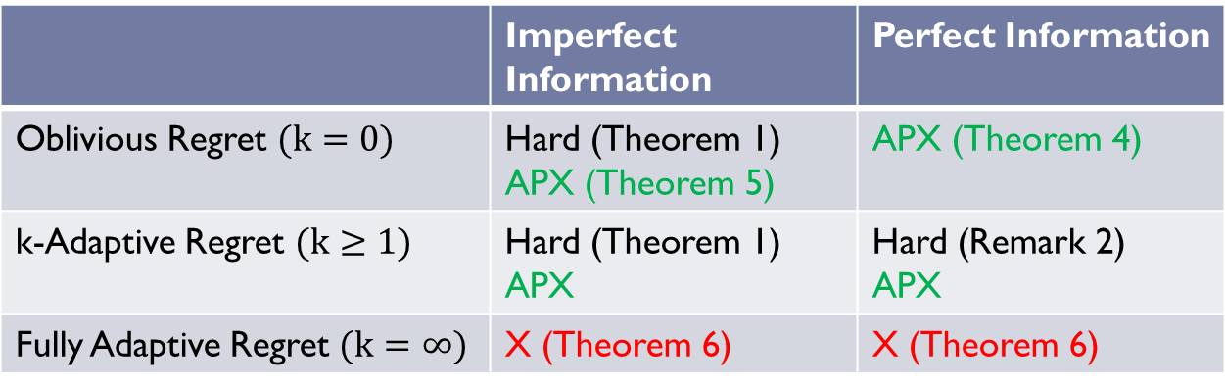

Open Questions
Perfect Information: efficient 𝛄-Approximate k-Adaptive Regret Minimization Algorithm when k = 0 and 𝛄 = 0?
𝛄-Approximate k-Adaptive Regret Minimization Algorithm with more efficient running time? $n^{O\left(log\left(1/γ\right)\right)}$?
 | Imperfect Information | Perfect Information
Oblivious Regret $(k=0)$ | Hard (Theorem 1) APX (Theorem 5) | APX (Theorem 4)
k-Adaptive Regret $(k≥1)$ | Hard (Theorem 1) APX | Hard (Remark 2) APX
Fully Adaptive Regret $(k=∞)$ | X (Theorem 6) | X (Theorem 6)

Slide 57

Thanks for Listening!

Slide 58
Theorem 3
Unless RP=NP there is no efficient Regret
Minimization algorithm for Bounded Memory Games even against an oblivious adversary.
Reduction from MAX 3-SAT
  (7/8+ε) [Hastad01]
  Similar to reduction in [EKM05] for MDP’s
Notes:
[EKM05] Considered Markov Decision Processes in a “changing dynamics model”
Different set up assumptions:
- No memory assumption

Slide 59
Theorem 3: Setup
Defender Actions A: {0,1}x{0,1}
m = O(log n)
States: Two states for each variable
  S₀ = {s₁,…, s_{n}}
  S₁ = {s’₁,…,s’_{n}}
Intuition: A fixed strategy corresponds to a variable assignment

Slide 60
Theorem 3: Overview
The adversary picks a clause uniformly at random for the next n rounds
Defender can earn reward 1 by satisfying this unknown clause in the next n rounds
The game will “remember” if a reward has already been given so that defender cannot earn a reward multiple times during n rounds
Notes:
Something fishy, game’s memory m = O(log n), how can

Slide 61
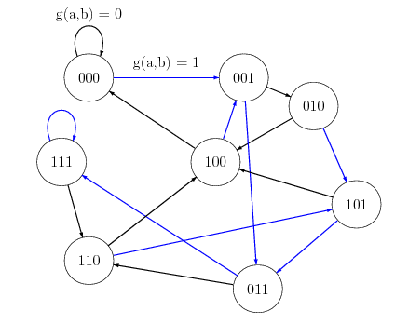
Theorem 3: State Transitions
Adversary Actions B: {0,1}x{0,1,2,3}
b = (b_{1,}b₂)
g(a,b) = b₁
f(a,b) = | S₁ if a₂ = 1 or b₂ = a₁ (reward already given)
 | S₀ else (no reward given)
Notes:
De Buijn Sequence
Player B completely controls the transitions between variables

Slide 62
Theorem 3: Rewards
b = (b_{1,}b₂)
No reward whenever B plays b₂ = 2
No reward whenever s  S₁
r(a,b,s) = | 1 if s  S₀ and a = b₂
 | -5 if s  S₁ and f(a,b) = S₀ and b₂  3
 | 0 otherwise
Notes:
Player A trapped in S₁ until
- Willing to pay -5 penalty
- Player B plays b₂ = 3
Thus the game can “remember” whether or not a reward has already been given or not

Slide 63
Theorem 3: Oblivious Adversary
(d₁,…,d_{n}) - binary De Buijn sequence of order n
Pick a clause C uniformly at random
For i = 1,…,n
  Play b = (d_{i},b₂)
Repeat Step 1
b₂ = | 1 | If x_{i}  C
 | 0 | If ➢x_{i}  C
 | 3 | If i = n
 | 2 | Otherwise

Slide 64
Analysis
f(a,b) = | S₁ if a₂ = 1 or b₂ = a₁
 | S₀ else
r(a,b,s)= | 1 if s  S₀ and a = b₂
 | -5 if s  S₁ and f(a,b) = S₀ and b₂  3
 | 0 otherwise
  Defender can never be rewarded from s  S₁
  Get Reward => Transition to s  S₁
  Defender is punished for leaving S₁
    Unless adversary plays b₂ = 3 (i.e when i = n)

Slide 65
Theorem 3: Analysis
φ - assignment satisfying ρ fraction of clauses
  f_{φ} – average score ρ/n
Claim: No strategy (fixed or adaptive) can obtain an average expected score better than ρ*/n
Regret Minimization Algorithm
  Run until expected average regret < ε/n
  Expected average score > (ρ*- ε )/n
Notes:
Either
1. If total runtime of Regret Minimization Algorithm to achieve expected average regret < ε/n is polynomial time then
2. RP = NP

